Slide 1

Introduction to NoSQL Databases
Notes:
Frequently, presenters must deliver material of a technical nature to an audience unfamiliar with the topic or vocabulary. The material may be complex or heavy with detail. To present technical material effectively, use the following guidelines from Dale Carnegie Training®.
Consider the amount of time available and prepare to organize your material. Narrow your topic. Divide your presentation into clear segments. Follow a logical progression. Maintain your focus throughout. Close the presentation with a summary, repetition of the key steps, or a logical conclusion.
Keep your audience in mind at all times. For example, be sure data is clear and information is relevant. Keep the level of detail and vocabulary appropriate for the audience. Use visuals to support key points or steps. Keep alert to the needs of your listeners, and you will have a more receptive audience.

Slide 2
Lecture will cover following points
Types of Data
Scaling Databases
The CAP Theorem and the BASE Properties
NoSQL Databases

Slide 3
Types of Data
Data can be broadly classified into four types:
Structured Data:
Have a predefined model, which organizes data into a form that is relatively easy to store, process, retrieve and manage
E.g., relational data
Unstructured Data:
Opposite of structured data
E.g., Flat binary files containing text, video or audio
Note: data is not completely devoid of a structure (e.g., an audio file may still have an encoding structure and some metadata associated with it)
Dynamic Data:
Data that changes relatively frequently
E.g., office documents and transactional entries in a financial database
Static Data:
Opposite of dynamic data
E.g., Medical imaging data from MRI or CT scans

Slide 4
Why Classifying Data?
Segmenting data into one of the following 4 quadrants can help in designing and developing a pertaining storage solution.
Relational databases are usually used for structured data.
File systems or NoSQL databases can be used for (static), unstructured data.
Dynamic
Static
Media Production, eCAD, mCAD, Office Docs
Media Archive, Broadcast, Medical Imaging
Unstructured
Transaction Systems, ERP, CRM
BI, Data Warehousing
Structured

Slide 5
Relational Databases Challenges
Fixed schemas
Complicated queries
Transaction overhead
Scalability

Slide 6
NoSQL databases
NoSQL databases are designed to handle
large databases challenges (millions of users, Internet giants like Amazon ,Google, Facebook etc. who deal with huge volumes of data.
Continuously changing nature of data- structured, Semi structured, unstructured nature of data

Slide 7
NoSQL
•Variable data
•Massive data
•Parallelism
•Simpler queries
•Relaxed consistency
•Easier/cheaper
NoSQL is not really about SQL but instead developing data management systems that are not relational.

Slide 8
Scaling Traditional Databases
Traditional RDBMSs can be either scaled:
Vertically (or Up)
Can be achieved by hardware upgrades (e.g., faster CPU, more memory, or larger disk)
Limited by the amount of CPU, RAM and disk that can be configured on a single machine
Horizontally (or Out)
Can be achieved by adding more machines
Requires database sharding and probably replication
Limited by the Read-to-Write ratio and communication overhead

Slide 9
Why Sharding Data?
Data is typically sharded (or striped) to allow for concurrent/parallel accesses
Input data: A large file
Machine 1
Machine 2
Machine 3
Chunk1 of input data
Chunk3 of input data
Chunk5 of input data
Chunk2 of input data
Chunk4 of input data
Chunk5 of input data
E.g., Chunks 1, 3 and 5 can be accessed in parallel

Slide 10
Some Guidelines
Here are some guidelines to effectively benefit from parallelization:
Maximize the fraction of your program that can be processed parallel
Balance the workload of parallel processes
Minimize the time spent for communication

Slide 11

Why Replicating Data?
Replicating data across servers helps in:
Avoiding performance bottlenecks
Avoiding single point of failures
And, hence, enhancing scalability and availability
Main Server
Replicated Servers

Slide 12
But, Consistency Becomes a Challenge
An example:
In an e-commerce application, the bank database has been replicated across two servers
Maintaining consistency of replicated data is a challenge
Event 1 = Add $1000
Event 2 = Add interest of 5%
1
2
Bal=2000
4
Bal=2100
Bal=1000
3
Bal=1000
Bal=1050
Bal=2050
Replicated Database

Slide 13
Evolving Database Requirements
Initially, databases serviced consumer applications.
These early applications put a priority on read access, because the ratio of reads to writes was very high. Delivering high-performance read access was the primary criteria. However, this is changing.
User generated content, particularly in the form of social networking, have placed somewhat more emphasis on updates.
Reads still outnumber writes in terms of the ratio, but the gap is narrowing.

Slide 14
Scalability
Scalability requirements:
Can change very quickly and,
Can grow very rapidly.
Difficult to manage with a single in-house RDBMS server.
RDBMS scale well:
When limited to a single node, but
Overwhelming complexity to scale on multiple server nodes.

Slide 15
NoSQL Based Solutions For Big Data

Slide 16
Overview
The problems with Relational Database:
Overhead for complex select, update, delete operations
Select: Joining too many tables to create a huge size table.
Update: Each update affects many other tables.
Delete: Must guarantee the consistency of data.
Not well-supported the mix of unstructured data.
Not well-scaling with very large size of data.
NoSQL is a good solution to deal with these problems.
Notes:
https://infocus.emc.com/april_reeve/big-data-and-nosql-the-problem-with-relational-databases/
1min

Slide 17
Overview
What is NoSQL:
NoSQL = Not only SQL
Wikipedia’s definition:
A NoSQL database provides a mechanism for storage and retrieval of data that is modeled in means other than the tabular relations used in relational databases.

Slide 18
Some Possible Characteristics
NOSQL – Comes in many different variants
Non-relational
Flexible schema
Less structured data
Other or additional query languages than SQL
Distributed – horizontal scaling
Scalable replication
No single point of failure
Supports big data
Open-source; Programming ease of use

Slide 19
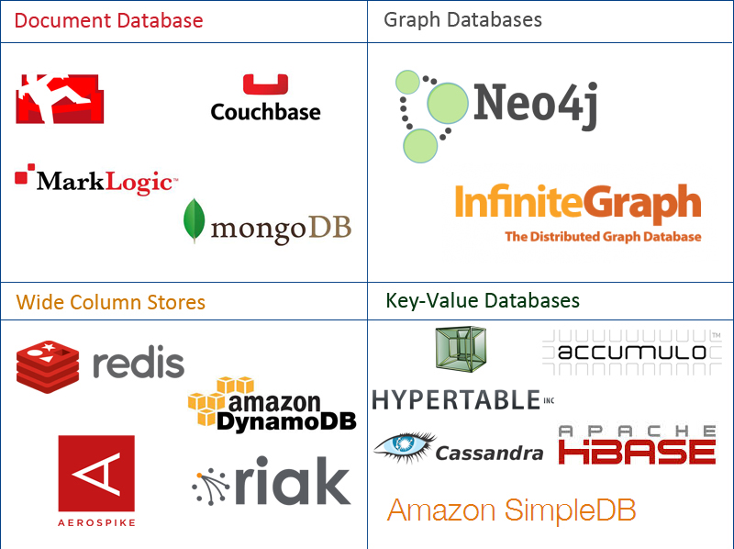
Overview – NoSQL Family
Data stored in 4 types:
Document
Graph
Key-value
Wide-column
Notes:
https://www.mongodb.com/nosql-explained http://aryannava.com/2014/04/06/nosql-databases-family/

Slide 20
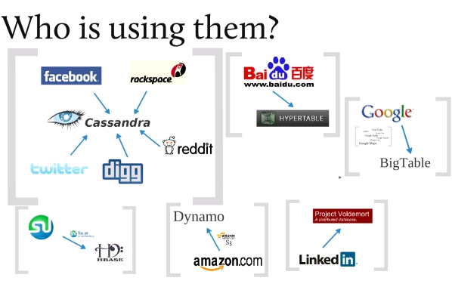

Slide 21
Cloud Data Management SQL or NoSQL ?
Scalability
Elasticity
Fault tolerance
Sacrifice consistency?

Slide 22
NoSQL
Main objective: implement distributed state
– Different objects stored on different servers
– Same object replicated on different servers
Main idea: give up some of the ACID constraints to improve performance
Eventual consistency 🡨 Strong consistency
CAP Theorem

Slide 23
Lecture will cover following points
The CAP Theorem and the BASE Properties
NoSQL Databases

Slide 24
The CAP Theorem
The limitations of distributed databases can be described in the so called the CAP theorem
Consistency: every node always sees the same data at any given instance (i.e., strict consistency)
Availability: the system continues to operate, even if nodes in a cluster crash, or some hardware or software parts are down due to upgrades
Partition Tolerance: the system continues to operate in the presence of network partitions
CAP theorem: any distributed database with shared data, can have at most two of the three desirable properties, C, A or P

Slide 25
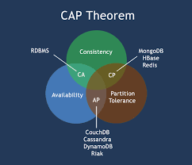

Slide 26

The CAP Theorem (Cont’d)
Let us assume two nodes on opposite sides of a network partition:
Availability + Partition Tolerance forfeit Consistency
Consistency + Partition Tolerance entails that one side of the partition must act as if it is unavailable, thus forfeiting Availability
Consistency + Availability is only possible if there is no network partition, thereby forfeiting Partition Tolerance

Slide 27
Large-Scale Databases
When companies such as Google and Amazon were designing large-scale databases, 24/7 Availability was a key
A few minutes of downtime means lost revenue
When horizontally scaling databases to 1000s of machines, the likelihood of a node or a network failure increases tremendously
Therefore, in order to have strong guarantees on Availability and Partition Tolerance, they had to sacrifice “strict” Consistency (implied by the CAP theorem)

Slide 28
Trading-Off Consistency
Maintaining consistency should balance between the strictness of consistency versus availability/scalability
Good-enough consistency depends on your application

Slide 29
Trading-Off Consistency
Maintaining consistency should balance between the strictness of consistency versus availability/scalability
Good-enough consistency depends on your application
Loose Consistency
Strict Consistency
Easier to implement, and is efficient
Generally hard to implement, and is inefficient

Slide 30
The BASE Properties
The CAP theorem proves that it is impossible to guarantee strict Consistency and Availability while being able to tolerate network partitions
This resulted in databases with relaxed ACID guarantees
In particular, such databases apply the BASE properties:
Basically Available: the system guarantees Availability
Soft-State: the state of the system may change over time
Eventual Consistency: the system will eventually become consistent

Slide 31
Eventual Consistency
A database is termed as Eventually Consistent if:
All replicas will gradually become consistent in the absence of updates

Slide 32
Eventual Consistency
A database is termed as Eventually Consistent if:
All replicas will gradually become consistent in the absence of updates
Webpage-A
Webpage-A
Webpage-A
Webpage-A
Webpage-A
Webpage-A
Event: Update Webpage-A
Webpage-A
Webpage-A
Webpage-A
Webpage-A
Webpage-A
Webpage-A

Slide 33
Eventual Consistency: A Main Challenge
But, what if the client accesses the data from different replicas?
Webpage-A
Webpage-A
Webpage-A
Webpage-A
Webpage-A
Webpage-A
Event: Update Webpage-A
Webpage-A
Webpage-A
Webpage-A
Webpage-A
Webpage-A
Webpage-A
Protocols like Read Your Own Writes (RYOW) can be applied!

Slide 34
Challenges with RDBMS
Impedance mismatch is a term used in computer science to describe the problem that arises when two systems or components that are supposed to work together have different data models, structures, or interfaces that make communication difficult or inefficient. This impedance mismatch can create challenges when it comes to mapping objects in code to tables in a database or vice versa.

Slide 35
NoSQL Databases
To this end, a new class of databases emerged, which mainly follow the BASE properties
These were dubbed as NoSQL databases
E.g., Amazon’s Dynamo and Google’s Bigtable

Slide 36
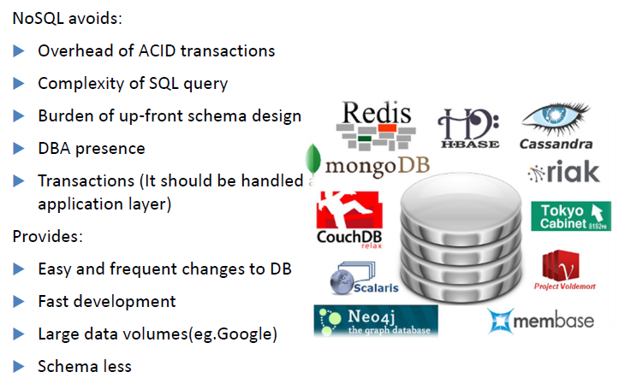
Characteristics of NoSQL databases
The structure or schema is defined upfront and data must conform to that schema before it can be ingested. This approach ensures data integrity and consistency, but it can be inflexible and time-consuming, especially when dealing with rapidly changing or unstructured data.

Slide 37
Why NoSQL now
New Trends

Slide 38
Types of NoSQL Databases
Here is a limited taxonomy of NoSQL databases:
NoSQL Databases
Document Stores
Graph Databases
Key-Value Stores
Columnar Databases

Slide 39
Document Stores
Documents are stored in some standard format or encoding (e.g., XML, JSON, PDF or Office Documents)
These are typically referred to as Binary Large Objects (BLOBs)
Documents can be indexed
This allows document stores to outperform traditional file systems
E.g., MongoDB and CouchDB (both can be queried using MapReduce)

Slide 40
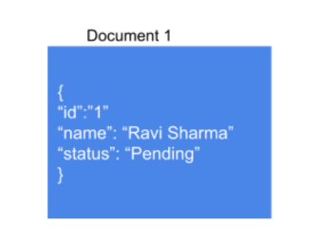
Document Stores
A document database is schema free, you don’t have to define a schema beforehand and adhere to it. Document stores make it easy to map Objects in the object- oriented software.
Document Stores: Features:
Features of document databases
Faster Querying
A large amount of data can be easily handled owing to its structure
Flexible Indexing

Slide 41
Document oriented database
A document database is used for content management applications such as blogs and video platforms.
No need to define schema as in relational model.
Avoids joining of relations
With a document database, each entity that the application tracks can be stored as a single document.
Document-oriented database contains documents, which are records that describe the data in the document, as well as the actual data.

Slide 42
Document oriented database
For example, suppose one document has two names, one address and ages of a family members. A second document might have four names, two addresses, and no age information.
A document-oriented database will take the data in both and store them according to type.
It is capable to handle non-fixed length data sets.
Examples: MongoDB, CouchDB, Terrastore

Slide 43
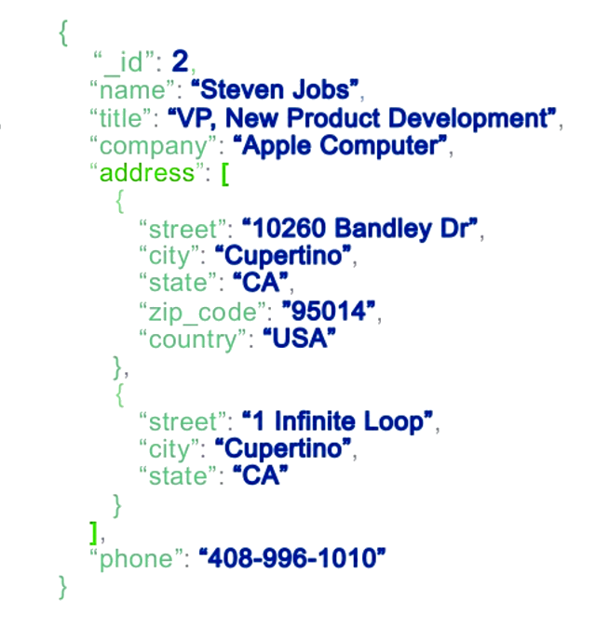
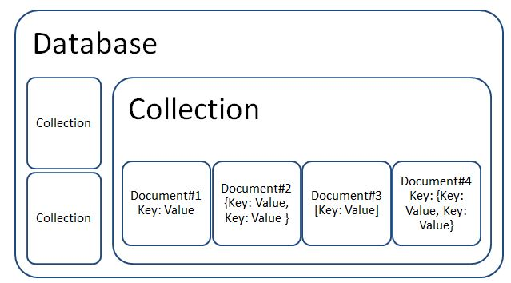
Document Oriented NoSQL
Catalog management, IoT data, Gaming,
Personalization, mobile apps…

Slide 44
Document Stores
Pros:
– Simple & Powerful Data model
– Scalable
– Open Formats
– No foreign Keys
Cons:
– Not suitable for relational data
– Querying limited to keys & indexes
– Map Reduce for more significant queries
Document Stores: Use Case:
User Profiles: Since they have a flexible Schema, the document can store different attributes and values. This enables the users to store different types of information.
Management of Content: Since it has a flexible schema, collection and storing any data has been made possible. This allows the creation of new types of content, including images, videos, comments, etc. Everyday use is seen in blogging platforms.
Some popular Document stores are MongoDB, CouchDB, Lotus Notes.

Slide 45
Key-Value Stores
Keys are mapped to (possibly) more complex value (e.g., lists)
For each Key, there is a value assigned to it. Each Key is unique and accepts only strings, whereas the value corresponding to the particular Key can accept String, JSON, XML, etc.
Owing to this behavior, it is capable of dealing with massive loads of data.
Keys can be stored in a hash table and can be distributed easily
KV stores resemble a relational database but with each table having only two columns.
Such stores typically support regular CRUD (create, read, update, and delete) operations
That is, no joins and aggregate functions
E.g., Amazon DynamoDB and Apache Cassandra

Slide 46
Type of Data in Key Value Database
Key Value pair: A field name together with the data entered into that field is a key- value pair.
Key should always be unique.
The value in a key-value store can be BLOB (Binary Large Object), such as text (long or short), a number, programming code such as PHP, an image, etc.
The value could also be a list, or even another key-value pair encapsulated in an object.
Advantages of key value Databases:
No foreign key constraints
No triggers
Joins must be done in code

Slide 47
Key Value Examples
Key | Value
supplier id | 1234
city | Indore
country | India
Order-no | G1298
Key | Value
123 | Aman, Buy, 45, 200.45
234 | Pankaj, Buy, 60, 3100.50
345 | Suman, Sell, 34, 456.34
456 | Preeti, Buy, 700, 36.50
This example uses a list as the value.
The list contains the stock trader, whether its a “buy” or “sell” order, the number of shares, and the price.

Slide 48
Key value Database
A Key value Database is suitable when
Unstructured data storage is required.
High performance read/writes are required
The value is fully identifiable via the key alone.
A Key value Database is not suitable when
Key value entries are related to each other
A set of keys values need to be updated in a single transaction.
Multiple keys require manipulation in a single operation.

Slide 49
Key-Value Stores
Key-Value Pairs Database: Features:
Consistency
Transactions
Query Features
Data Structure
Scaling
Pros:
– Simple Data model
– Scalable
– Value can include JSON, XML, flexible schemas
– Extremely Fast Owing to it’s simplicity
– Best fit for cases where data is not highly related
Cons:
– No relationships, create your own foreign keys
– Not suitable for complex data
– Lacks Scanning Capabilities
– Not ideal for operations rather than CRUD (create, read, update Delete )

Slide 50
Key-Value Stores (Use Cases)
These kinds of databases are best suited for the following cases:
Storing session information: offers to save and restore sessions.
User preferences: Specific Data for a particular user
Shopping carts: easily handle the loss of storage nodes and quickly scale Big data during a holiday/sale on an e-commerce application.
Product recommendations: offering recommendations based on the person’s data.
Popular KV Stores would include Dynamo DB, Redis, BerkleyDB.

Slide 51
Columnar Databases
Columnar databases are a hybrid of RDBMSs and Key-Value stores
Values are stored in groups of zero or more columns, but in Column-Order (as opposed to Row-Order)
Values are queried by matching keys
E.g., HBase and Vertica
Record 1
Column A
Column A = Group A
Alice
3
25
Bob
Alice
Bob
Carol
Alice
Bob
Carol
4
19
Carol
0
3
4
0
25
3
25
4
19
45
19
45
0
45
Column Family {B, C}
Row-Order
Columnar (or Column-Order)
Columnar with Locality Groups

Slide 52
Columnar Databases
A columnar database is a database management system (DBMS) that stores data in columns instead of rows. The goal of a columnar database is to efficiently write and read data to and from hard disk storage in order to speed up the time it takes to return a query.
Stores data by column.
Keeps all attribute information together.
Handles fixed length data.
Examples are Bigtable, Cassandra, Hbase, Vertica, Accumulo, Hypertable

Slide 53
Columnar Databases
Compression
Aggregation queries like min , max, count
Scalability
Fast to load and query

Slide 54
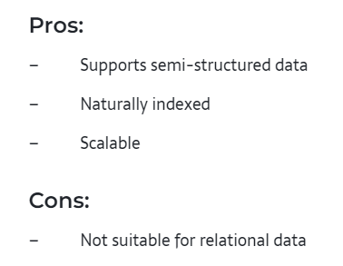
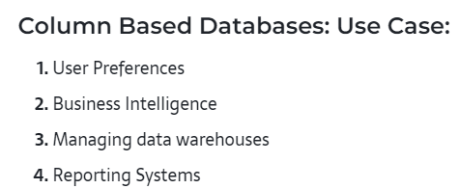
Columnar Databases

Slide 55
Graph Databases
Data are represented as vertices and edges
Graph databases are powerful for graph-like queries (e.g., find the shortest path between two elements)
E.g., Neo4j and VertexDB
Id:100
Label: knows
Since: 2001/10/03
Id: 2
Name: Bob
Age: 22
Id:101
Label: knows
Since: 2001/10/03
Id: 1
Name: Alice
Age: 18
Id:105
Label: is_member
Since: 2011/02/14
Id:104
Label: Members
Id:103
Label: Members
Id: 3
Name: Chess
Type: Group
Id:102
Label: is_member
Since: 2005/07/01

Slide 56
Graph Databases
A graph database is a type of NoSQL database that uses graph theory to store, map and query relationships.
The graph is a collection of nodes and edges where each node is used to represent an entity and each edge describes the relationship between entities.
Graph databases are basically used for analyzing interconnections. For example, companies might use a graph database to mine data about customers from social media.

Slide 57
Graph Databases
A graph database is any storage system that provides index-free adjacency. This means that every node contains a direct pointer to its adjacent element and no index lookups are necessary. As the number of nodes increases, the cost of a hop remains the same.
Graph Databases: Features:
Features of graph databases
Flexibility
Agility
Improved performance, even with huge volumes of data.
Typical use cases for graph databases would include social networking site, recommendation engine.

Slide 58
Graph Databases
Pros:
– Extremely powerful
– Connected data is locally indexed
– Can provide ACID
– Results in real-time
– Agile Structure
Cons:
– Difficult to scale out, though can scale up

Slide 59
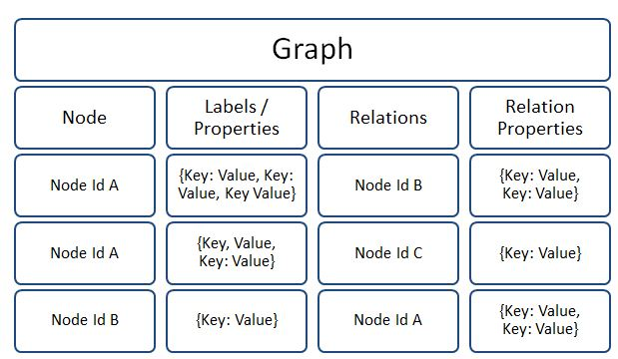
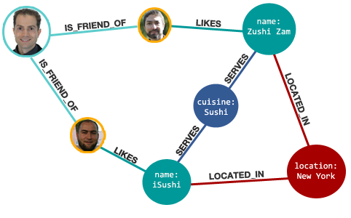
NoSQL Graph Databases
Recommendations, Fraud Detection, manage complex interdependencies in telecommunications, IT infrastructure, supply-chain management…..

Slide 60
Thankyou

